Slide 1
Oil Slicks
Jaramillo,Lajeunesse, Moore, Binns, Thomas, Green
BUS 341 PROJECT MANAGEMENT
NOVEMBER 25, 2019

Slide 2
Company Overview
BP is one of the largest and most successful leaders in the field of oil production..
BP’s CEO, Lord John Browne, improved the vision of BP but may have left a legacy of poor risk culture.
Commissioned reports from Telos Group and United States Chemical Safety and Hazard Investigation Bound found multiple discrepancies in the management of the company’s safety procedures.
BP left with poor public credibility, discontented shareholders and a high rate of employee death.

Slide 3
Team Charter
Start Date: November 2nd 2019 to November 25th 2019
Team Purpose
The team will strive for project completion in the time frame given by the professor, and also produce a well thought detailed powerpoint presentation.
Duration and Time Commitment
The team has been given class time to work together for 3 weeks executing the five stages of team development forming, storming, norming, performing followed by adjourning. The daily efforts will average 25% of team members time, due to class, and other daily activities beyond the classroom.
Members
Binns: Introduction & Company Overview
Green : Team Charter
Moore : Org. Readiness & Risk Culture/Project Benefits/Color/Formatting
Thomas: Risk Breakdown Structure/Critical Success Factors
Lajeunesse : Work Breakdown Structure
Jaramillo : Budget

Slide 4
Team Charter Cont.
No shows are not tolerated within the team’s designated meeting times, so in result of 2 no shows you the member will be immediately dropped from the project and no longer able to receive your grade.
We ask that team members have completed their part of the project within the 48 hour due date so team leads can look over and correct any errors.
Each week a standing vote will be used to select a new team lead.
Each week we will rotate positions amongst members, a sign in sheet will be in the beginning of the class first come first serve SO BE ON TIME.
Expectations
ALL TEAM MEMBERS WORK HARD AND RECEIVE A’s simple
#NoWorkNoA
Members who show little to no effort in taking part in the project completion will be jumped and or pushed down a flight of steps by the team.

Slide 5
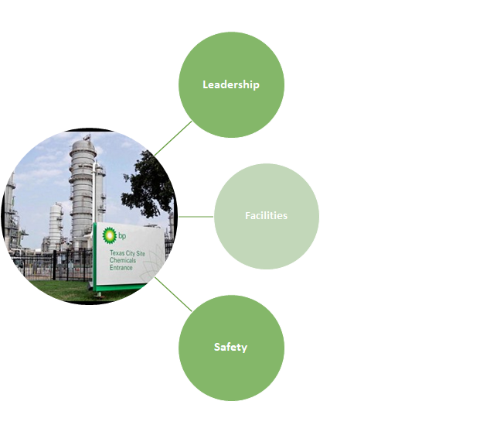
Organizational Readiness/Risk Culture
Key Factors
Leadership
BP cut fixed cost by 25% at all refineries
Company officials ignored warnings signs of impending disasters
Facilities
There were 23 fatalities in the previous 30 years
Since 2002 there was an average of one fire per week
Machinery was not adequately fixed ( Band - Aid)
Safety
Employees were not able to follow safety procedures (Training)
Plant personnel was pressured not to report injuries and safety violations

Slide 6
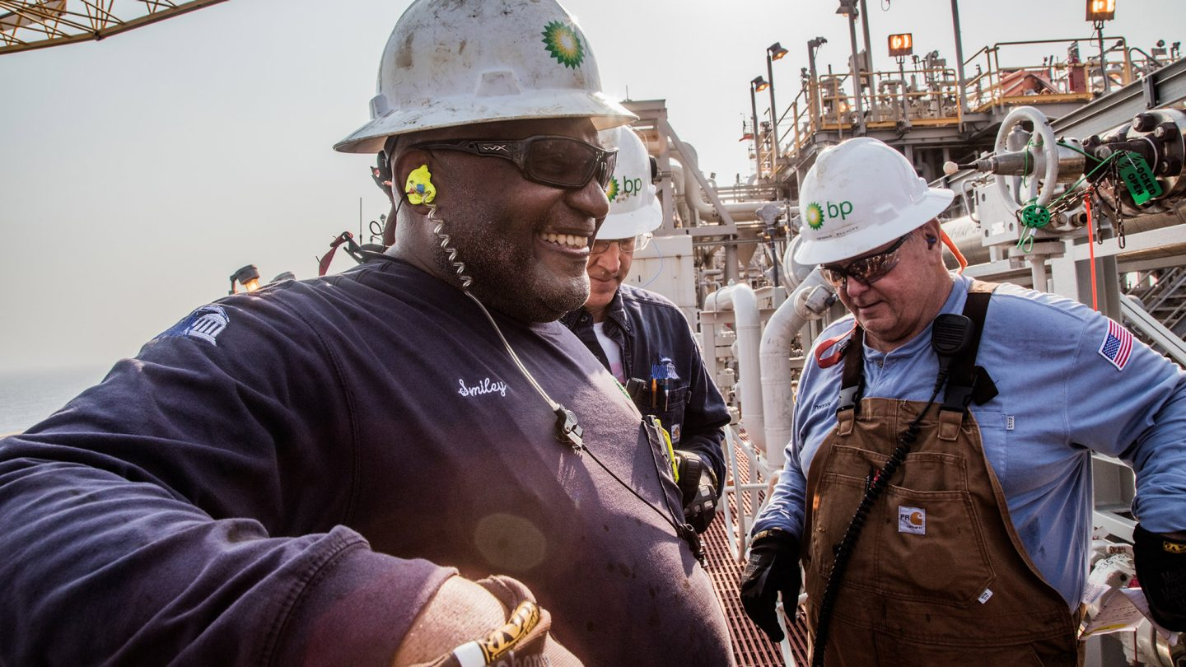
Project Benefits
Reduces accidents & plant violations
Enhances worker morale
Satisfies regulatory compliance (OSHA)
Improves transparency between management and staff
Decreases civil liability cases (↑$)

Slide 7
Critical Success Factors
Strategic: Have management and leaders within the company comply with safety compliances and regulations.
People: Teach and orient new and old employees to proper safety and service procedures.
Operations: Have all employees follow one guideline to safety procedures throughout British Petroleum’s refineries.
Marketing: Demonstrate the changes and impacts to ensure customer relations are in good state and regain their trust.
Finances: Make safety a priority and do not make financial cuts into this asset.

Slide 8
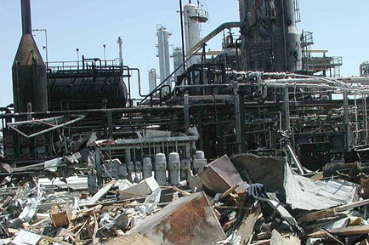
Risk Breakdown Structure
Start from corporate all the way down to floor employee and endure safety protocols to them. (CEO, Managers, Leaders, Staff)
Begin having preventative maintenance to the refinery to avoid repair costs.
Provide funding for safety and operational readiness.

Slide 9
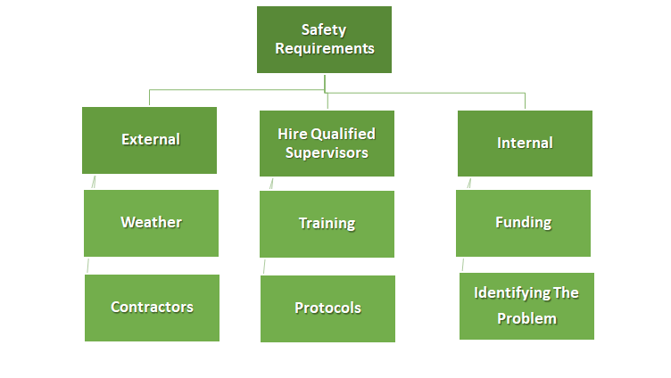
Work Breakdown Structure

Slide 10
Budget
Human Resources: $3,400,000.00
Hiring Experienced and Trained Managers:
Operations Manager: $400,000.00 p/y salary
Trained Maintenance Crew: $900,000.00 (15)
Supervisor Training: $450,000.00
Training Current Employees: $1,350,000.00
Development of company’s S.O.P.: $300,000.00
Outsource: $23,000,000.00
External Contractors: $6,250,000.00
Social Media: $4,250,000.00
Legal: $12,500,000.00
Total: $27,400,000.00

Slide 11
?
Thank you
Oil Slicks

Slide 12
References
Graves, J., Purcell, T., Flowers, C., Funt, P., Reagan, M., Shannon, M., … Manieri, R. (n.d.). Retrieved from https://www.cagle.com/tag/bp/page/29/ https://www.pophistorydig.com/topics/bp.
J.d. (2016, April 28). Retrieved from https://www.pophistorydig.com/topics/bp-texas-city-disaster/.
Gray, C. F., & Larson, E. W. (2018). Project management: the managerial process. New York, NY: McGraw-Hill Education.
Hunter, T. (2008). British Petroleum (Plc) And John Browne: A Culture Of Risk Beyond Petroleum. BRITISH PETROLEUM (PLC) AND JOHN BROWNE: A CULTURE OF RISK BEYOND PETROLEUM (pp. 1–13). Ivey Publishing.
Friedman, B. (n.d.). BP Reports Hundreds of Thousands of Pounds of Toxic Emissions at Deadly Texas City Refinery. Retrieved from https://www.bradblog.com/?p=7877.
Picture show: the faces and places of BP in 2017: News and insights: Home. (n.d.). Retrieved from https://www.bp.com/en/global/corporate/news-and-insights/bp-magazine/bp-best-of-2017-in-pictures.html.

