Slide 1
EDF 6229
Module 7:
Mathetics & Direct Instruction
Dr. Kerri Milyko, BCBA-D, LBA
Applied Behavior Analysis

Slide 2
Mathetics
Mathetics
Has nothing to do with MATH! ;)
Systematic methods of planning the course of human learning
A form of instruction with various steps:
Demonstrate/Model
Prompt/Lead
Test/Release

Slide 3
Model
“My Turn” - or the SO (observing stimulus)
Learners look to the teacher for the model
Teacher demonstrate mastery
Focuses learner to the SD

Slide 4
Lead
“Our Turn” - prompted SD
Therapist/Teacher practices with the learner
Help learners to perform accurately
Often when they identify the boundaries of the concept

Slide 5
Release
“Your Turn” - Freely perform the skill; spontaneous completion
Learner demonstrates mastery
No guidance
Learner is released to perform on his own

Slide 6
Lecture Verification #1 out of 2
What are the 3 phases of Mathetics?

Slide 7
Applications of Mathetics
Direct Instruction
Siegfried Englemann (1970s)
Purpose
Build consistency across teachers
Methods for students to “grasp” concepts
Scope/sequence of skills
Component/composite relations

Slide 8
Features of DI
Scope & Sequence
First things first
Master pre-reqs
Concept Learning
Clear rules
Examples/Non-examples
Instruction until reliable responding
Modified instruction to fit learner
Instructor Flexibility
Use scripts, but flexible within the scripts
Different examples/non-examples
Building listening comp
Choral Responding
Learners actively respond
Identifies errors
Paced instruction
Avoid the void
Signals
When to respond
Paced instruction
Scripts
Consistency
Provide models
Sensitivity to the Learner
Modifications if needed
Model prompts

Slide 9
Application of Mathetics to DI
Level 1: Verbatim MODEL
Run script as-is, in order, but with different examples/nonexamples
Level 2: Flex LEAD
Run script in different order with “curve balls”
Level 3: Student Teach RELEASE
Student can act like the instructor
Student can just give a Free/Say everything he/she knows about the topic

Slide 10
DI Script: FLEX/ “Our Turn”

Slide 11
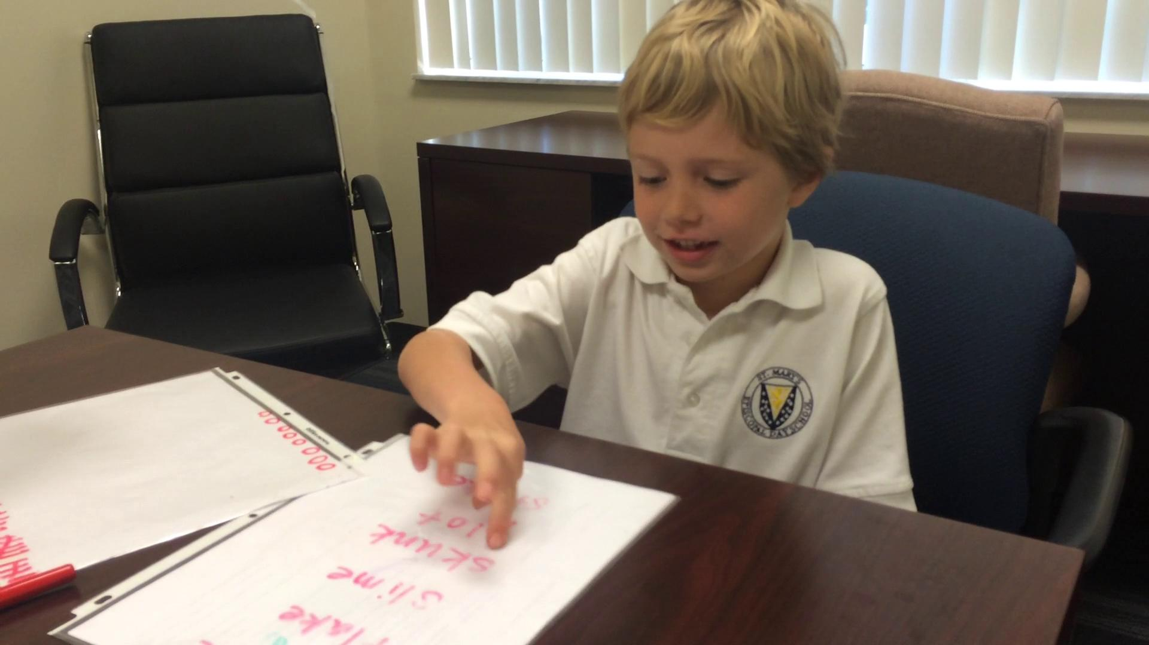
DI Script: Student Teach/ “Your Turn”

Slide 12
Creating your own DI
Actually “di” because “DI” is a brand
Select your concept
Break it down into “learned parts”
RULEG

Slide 13
RULEG
“The RULEG system is based on the premise that the verbal subject material which appears in a program can be classified into 2 classes of statements which we call RUs (for RUles)and EGs (for examples).”
Markle (1978)

Slide 14
RU
Statements that you can DO something with, show, and apply
Definitions
Laws

Slide 15
Is this an RU? (1)
The Mississippi is the largest river in North America.

Slide 16
Is this an RU? (1) Answer
The Mississippi is the largest river in North America.
No - can’t DO anything with this (a statement but cannot be applied)

Slide 17
Is this an RU? (2)
In a CVC”e” word, the “e” at the end of the word makes the vowel say its name.

Slide 18
Is this an RU? (2) Answer
In a CVC”e” word, the “e” at the end of the word makes the vowel say its name.
Yup - it is a statement that can be applied

Slide 19
Is this an RU? (3)
George Washington was the first president of the United States of America.

Slide 20
Is this an RU? (3) Answer
In a CVC”e” word, the “e” at the end of the word makes the vowel say its name.
Nope - can’t apply this statement

Slide 21
Is this an RU? (4)
When multiplying/dividing integers, two negatives make a positive.

Slide 22
Is this an RU? (4) Answer
When multiplying/dividing integers, two negatives make a positive.
Yup! You can apply this to multiple math problems.

Slide 23
Is this an RU? (5)
The prefix “re” means “to do again”

Slide 24
Is this an RU? (5) Answer
In a CVC”e” word, the “e” at the end of the word makes the vowel say its name.
Yup - you can DO something with this statement by applying to words

Slide 25
EGs and NEGs
Example (EG)
application of rule to a particular target
Nonexample (NEG)
when that application DOESN’T work

Slide 26
Pick out the EG and NEG
A: “Re” is a prefix meaning “again”
B: Reapply
C: Read

Slide 27
Label RU, EG, NEG (1)
A: “Re” is a prefix meaning “again”
B: Reapply
C: Read

Slide 28
Label RU, EG, NEG (Answer 1)
RU: “Re” is a prefix meaning “again”
EG: Reapply
NEG: Read

Slide 29
Label RU, EG, NEG (2)
A: -4 x -4 = 16
B: -4 + -4 = -16
C: Two negatives make a positive

Slide 30
Label RU, EG, NEG (Answer 2)
EG: -4 x -4 = 16
NEG: -4 + -4 = -16
RU: Two negatives make a positive

Slide 31
DI Script Forumula
Script Formula:
RU + RU
EG + EG
RU + EG
NEG + NEG
RU + EG + EG + EG….

Slide 32
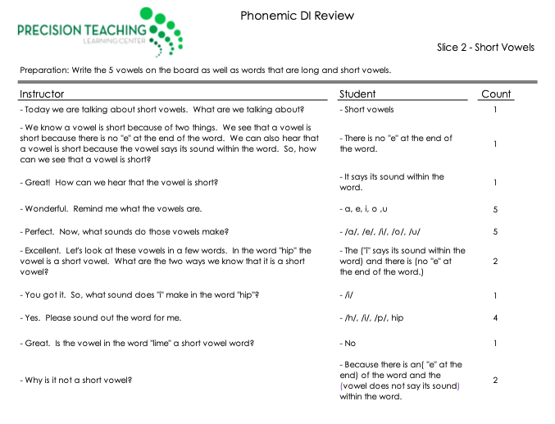
Phonemic DI Review

Slide 33
Lecture Verification #2 out of 2
Give an example of an RU, EG, and NEG for one of the following:
making coffee
using APA format
answering an email

Slide 34
Take Home

Slide 35
Summary
Greater concepts can also be taught via good instructional design
Mathetics is a systematic process that guides the teacher to fade out involvement
Mathetics is applied in Direct Instruction
Direct Instruction uses rules, examples, and nonexamples to teach concepts
Similar to concept formation of bunny, but at a more sophisticated scale

Slide 36
Assignment
If applicable to your pinpoint or not, write a direct instruction script using the RU, EG, and NEG formula
Pick any concept that you like
Make the duration of the script no longer than 2-3 min when read aloud
Color code your RU (blue), EG (green), and NEG (purple)

