Slide 1
Mitigating Risk with a Computer Incident Response Team Plan
CHAPTER 15

Slide 2
Learning Objective(s) and Key Concepts
Learning Objective(s)
Key Concepts
Perform business continuity, disaster, and incident response planning.
Definition of a computer incident response team (CIRT) plan
Purpose of a CIRT plan
Elements of a CIRT plan
How a CIRT plan can mitigate an organization’s risk
Best practices for implementing a CIRT plan

Slide 3
Computer Security Incident
A violation or imminent threat of a violation of a security policy or security practice
Examples
Denial of service (DoS) attack
Malicious code
Unauthorized access
Inappropriate usage
Multiple component

Slide 4
What Is a Computer Incident Response Team Plan?
Computer incident response team (CIRT)
A group of people who respond to incidents
A CIRT plan
Formal document that outlines an organization’s response to computer incidents
Formally defines a security incident
May designate the CIRT team

Slide 5
Purpose of a CIRT Plan
Helps organizations identify and prepare for computer incidents
Applies critical thinking to solve potential problems
Helps develop best responses to reduce damage
Outlines the purpose of the response effort
The five Ws: what, where, who, when, and why

Slide 6
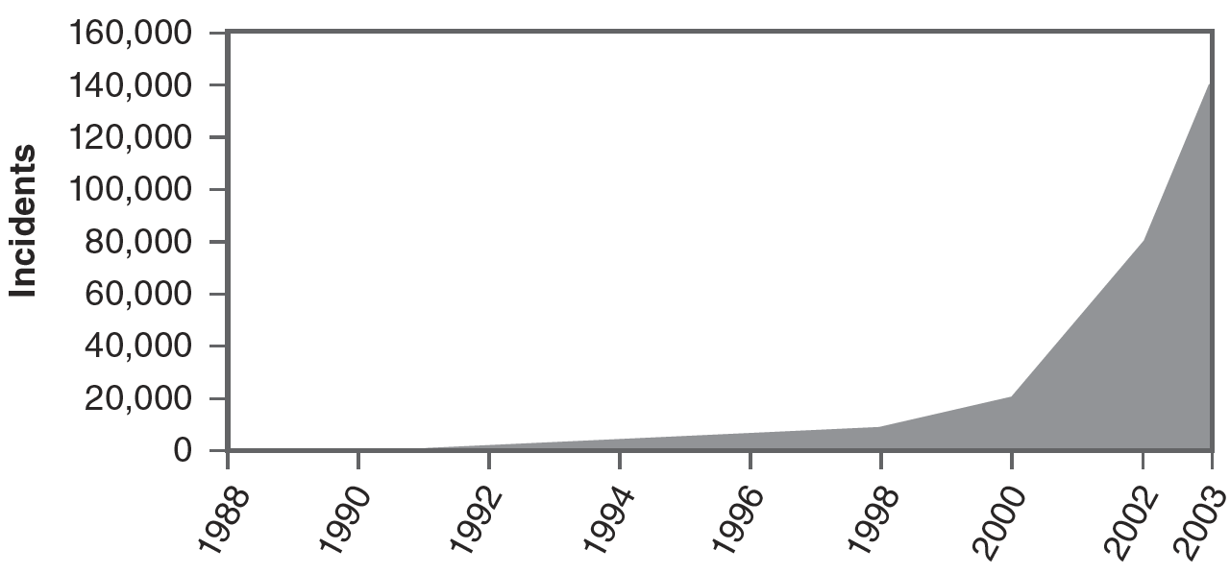
Growth of Incidents
1988 – one incident was news
2003 – 137,529 incidents
Today – off the charts

Slide 7
Elements of a CIRT Plan
CIRT members
IT staff and security professionals who understand risks and threats posed to networks and systems
Roles, responsibilities, and accountabilities
CIRT policies
Incident handling process
Communication escalation procedures
Incident handling procedures

Slide 8
CIRT Members
Team leader
Information security members
Network administrators
Physical security personnel
Legal
Human resources (HR)
Communications

Slide 9
Responsibilities
Developing incident response procedures
Investigating incidents
Determining the cause of incidents
Recommending controls to prevent future incidents
Protecting collected evidence
Using a chain of custody

Slide 10
Accountabilities
Accountable to the organization to provide a proactive response to any incident
Expected to minimize the impact of any incident
Expected to keep up to date on security threats and possible responses
Dedication on the part of each team member

Slide 11
CIRT Policies
May be simple statements or contained in appendixes at the end of the plan
Provide the team with guidance in the midst of an incident
Primary policy to consider: whether or not CIRT members can attack back
Best practice is not to escalate an attack into a two-sided conflict
Leave retribution to law enforcement.
Other policies may be related to:
Evidence
Communications
Safety

Slide 12
Incident Handling Process
Four phases defined by NIST SP 800-61

Slide 13
Handling DoS Attack Incidents
DoS attacks attempt to prevent a system or network from providing a service by overwhelming it to consume its resources.
Indications that a DoS attack is occurring:
User reports of system unavailability
Intrusion detection system (IDS) alerts on the attack
Increased resource usage on the attacked system
Increased traffic through the firewall to the attacked system
Unexplained connection losses
Unexplained system crashes
Suspected attack can be confirmed by reviewing available logs

Slide 14
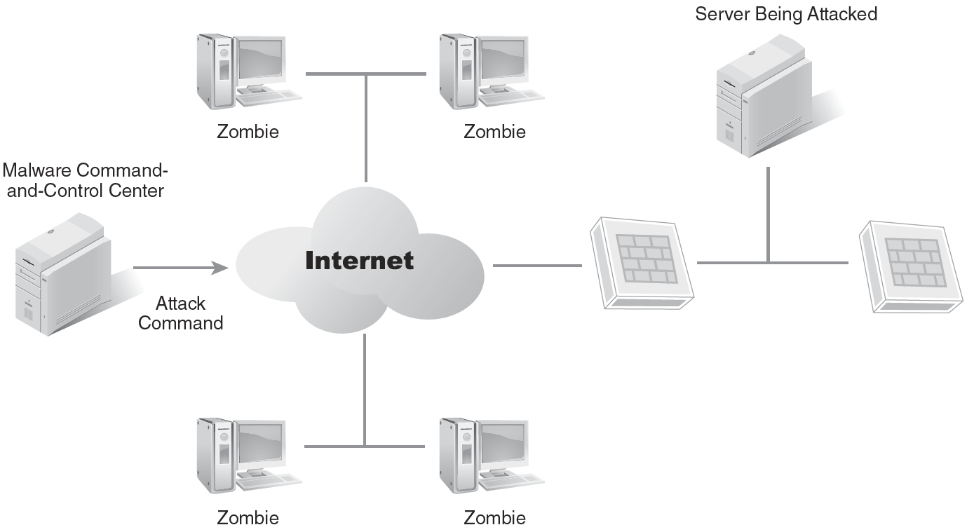
Handling DoS Attack Incidents (Cont.)
Distributed denial of service (DDoS) attack from a botnet
What are the implications on the attacked server?

Slide 15
Handling Malware Incidents
Viruses
Worms
Mobile code
Trojan horses
Primary protection is antivirus software
Secondary protection is to train and educate users
Create checklists that identify what users should do if their systems are infected
If malware infects an email server, isolate the server
Configure web browsers and email readers to prevent the execution of malicious mobile code

Slide 16
Handling Unauthorized Access Incidents
Examples:
Viewing or copying sensitive data without authorization
Using social engineering
Guessing or cracking passwords and logging on with these credentials
Running a packet sniffer, such as Wireshark, to capture data transmitted on the network
Hardening steps:
Reducing the attack surface
Keeping systems up to date
Enabling firewalls
Enabling IDSs

Slide 17
Handling Inappropriate Usage Incidents
Examples:
Spamming coworkers
Accessing websites that are prohibited
Circumventing security policies
Using file sharing or P2P programs
Sending files with sensitive data outside the organization
Launching attacks from within the organization against other computers
Means of prevention:
Security policies and acceptable use policies (AUPs)
Alerts
Log reviews
Reports by other users
Data loss prevention (DLP) software

Slide 18
Handling Multiple Component Incidents
Multiple component incident is a single incident that includes two or more other incidents, which are related to each other but not always immediately apparent
Steps to take:
Identify the root cause of an incident.
Remote the root cause, if possible.
Example:
Incident 1: A user opens a malicious email attachment infects the system.
Incident 2: The malware releases a worm that infects other computers on the network.
Incident 3: The malware contacts a server, which forms a botnet. Infected systems on the network find other systems to infect.

Slide 19
Communication Escalation Procedures
Escalation
When someone determines an event is an incident and declares it
One of the first steps is to recall one or more CIRT members
If the incident is worse than expected:
CIRT member can escalate the response
Organization can activate the full CIRT
If ordinary communications are hampered:
CIRT members can be issued push-to-talk phones or walkie-talkies
A war room can be set up for face-to-face communications

Slide 20
Incident Handling Procedures
Calculating the impact and priority
Using a generic checklist
Handling DoS attack incidents
Handling malware incidents
Handling unauthorized access incidents
Handling inappropriate usage incidents

Slide 21
Calculating the Impact and Priority (Example)
Current effect rating
Minimal because the attack is currently affecting only one web server in the web farm. Score of 10. This rating will be used for 25 percent, or one-quarter, of the overall impact score (10 × .25 = 2.5).
Projected effect rating
Medium because the attack has the potential to spread to more web servers in the web farm. Score of 50. This rating will be used for 25 percent, or one-quarter, of the overall impact score (50 × .25 = 12.5).
Criticality rating
Medium because the web server does affect a mission-critical system in a single location. Score of 50. This rating will be used for 50 percent, or one-half, of the overall impact score (50 × .50 = 25).

Slide 22
Calculating the Impact and Priority (Example) (Cont.)
The following formula can then be used to determine the impact:
(Current effect rating × .25) + (Projected effect rating × .25) + (Criticality rating × .50)
(10 × .25) + (50 × .25) + (50 × .50)
2.5 + 12.5 + 25
Incident impact score = 40

Slide 23
Using a Generic Checklist
Verify that an incident has occurred
Determine the type of incident
Determine the impact or potential impact of the incident
Report the incident
Acquire any available evidence on the incident
Contain the incident
Eradicate the incident
Recover from the incident
Document the incident

Slide 24
Handling DoS Attack Incidents
Containment
Add filters at routers or firewalls to block the traffic based on the IP address, port, or protocol used in the attack
Recovery
Repair and test the affected system
Contact the Internet service provider (ISP)
Eradication
Identify vulnerabilities and take steps to mitigate them

Slide 25
Handling Malware Incidents
Containment
Identify infected systems
Eradication
Run full scans on systems
Recovery
Replace deleted or quarantined files needed for system operation
Disconnect them from the network
Determine why antivirus software didn’t detect the malware
Remove all elements of the malware from the system
Disinfect, quarantine, or delete infected files
Verify the system is no longer infected
Run another full scan before returning the system to operation

Slide 26
Handling Unauthorized Access Incidents
Containment
Eradication
Recovery
Identify and isolate attacked system from the network
Block all traffic at firewall; log attempts to connect
Disable internal account (if source) and verify least privilege
Identify weaknesses that allowed attack to succeed
Verify system hardening
Disable/delete addl accounts created during attack
Resolve vulnerabilities
Reconnect, verify, and test systems
Consider adding monitoring, such as an IDS

Slide 27
Handling Inappropriate Usage Incidents
Containment
Eradication
Recovery
Disable user’s account until management takes action
Require specific user training before access is returned
Document activity in employee’s record
Enable account after appropriate action has been completed

Slide 28
How Does a CIRT Plan Mitigate an Organization’s Risk?
Quick and focused response to incidents
Clearly defined roles and responsibilities
Enhanced understanding of needed skills
Enhanced ability to respond to threats and attacks

Slide 29
Best Practices for Implementing a CIRT Plan
Define a computer security incident
Include policies in CIRT plan to guide members
Provide training
Develop CIRT checklists
Subscribe to security notifications

Slide 30
Summary
Definition of a computer incident response team (CIRT) plan
Purpose of a CIRT plan
Elements of a CIRT plan
How a CIRT plan can mitigate an organization’s risk
Best practices for implementing a CIRT plan

